Slide 1
Predicting voting patterns based on demography
Michael Yee
Nicholas Wood

Slide 2
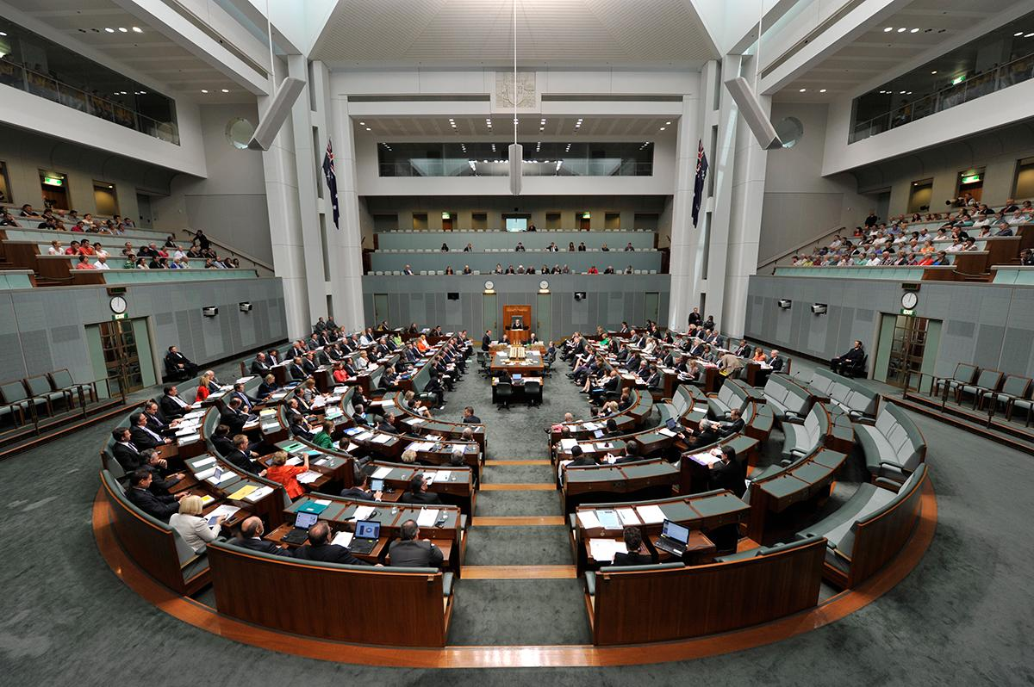
The Australian federal government
As stated in section 28 of the constitution, every 3 years the lower house must have an election called to determine which political party will hold office.
Senate seats last for 6 years but hold elections for half of the seats every 3 years on a rotational basis.
We will focus on predicting the lower house as that determines who is prime minister.
There are 151 federal electorates.
Electoral seats are determined through vote counts via preference voting.

Slide 3
Problem statement
Primary Goal: To be able to accurately predict the outcome of a vote in an electorate based off of its demographics.
Secondary Goals:
Determine what are the key demographic factors that determine the political affiliation of an electorate.
Develop demographic profiles that are characteristic of a given political party’s strength in a particular electorate.

Slide 4
Data Sources
Census Data
2016 National Census
Provided by the Australian Bureau of Statistics (ABS)
Electoral Data
2019 Federal Election
Provided by the Australian Electoral Commission (AEC)
Census data can be extracted at the CED level and electoral data is provided at CED level
However...

Slide 5
Electorate redistributions
A state or territory may redistribute the boundaries of electoral districts
Goal is to balance electorate areas so they contain similar numbers of people
May be required if seat allocation is increased/decreased or due to population changes
There were 84 electorates affected by redistributions between the 2016 census and the 2019 Federal election
Therefore, 2016 census data by electorate may not reflect the demographics as of the 2019 Federal election

Slide 6
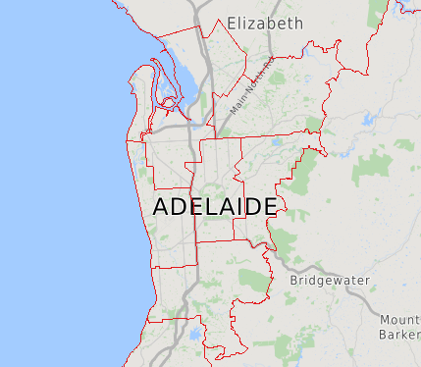
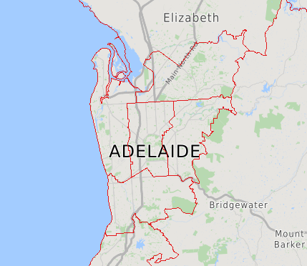
2018 South Australia redistribution
CED boundaries before redistribution
CED boundaries after redistribution

Slide 7
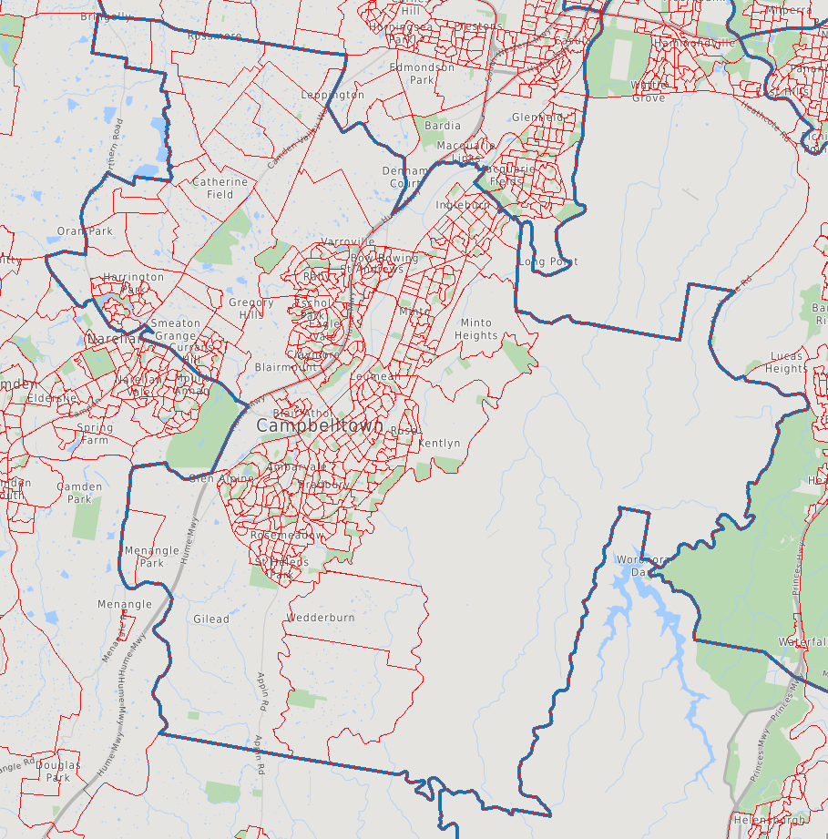
SA1s and CEDs
The Statistical Area Level 1 (SA1) is a geographical area with an average population size of 400 people
The ABS provides a correspondence of CEDs to SA1s in different years
The SA1 boundaries did not change between 2016 and 2019
Therefore, population totals can be aggregated by SA1 and transferred between CEDs where the CED boundary changed between 2016 and 2019
Electorate of Macarthur (CED boundaries in blue, SA1 boundaries in red)

Slide 8
Logistic regression model
2 Sets of Models were developed
Major Party Model
Divides seats into 3 categories (ALP, LNP & Other)
Seat Type Model
Further divides seat into their strength of victory based off of AEC definitions:
Marginal (50-56% Win)
Fairly Safe (56-60% Win)
Safe (60%+ Win)
This gives us a total of 6 categories:
Marginal
Fairly Safe ALP
Fairly Safe LNP
Safe ALP
Safe LNP
Other
Both models start on 138 variables.
Variables are from the normed master DataFrame.
RFE feature selection whittles down these variables into only the most important.
The interpretation of the model will be how proportions of specified demographics determine the category.

Slide 9
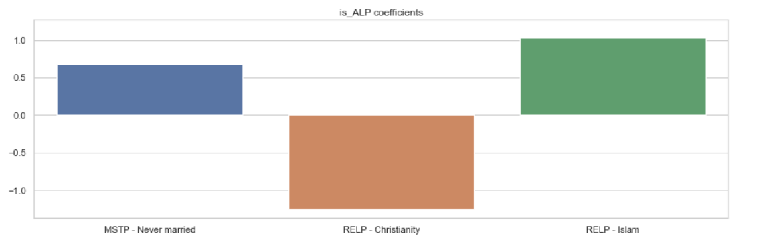
Results (Major Party Model)
Major Party Model
Overall Model Accuracy is 67%.
Predicts an LNP Victory (103 to LNP, 48 to ALP)
61% Accurate at predicting if an electorate is a Labor seat.
Major ALP determinants:
Positive:
Never being married
Islam
Negative:
Christianity

Slide 10
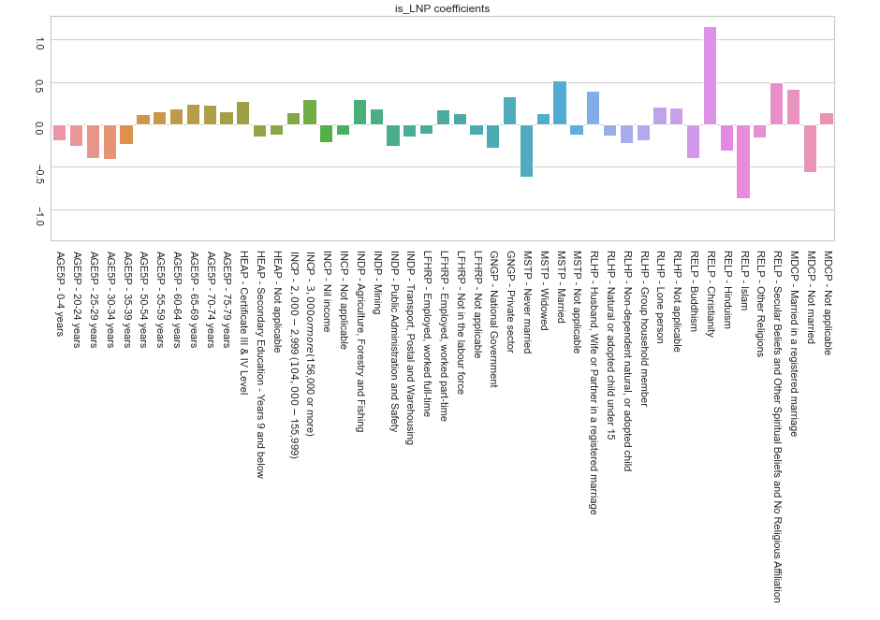
Results (Major Party Model)
65% Accurate at predicting if an electorate is a Liberal/ National coalition seat.
Major LNP determinants:
Positive:
Chrsitianity
Being Married
Secular beliefs
Negative:
Islam
Never being married
Not currently married
94% Accurate at predicting if an electorate is Other.

Slide 11
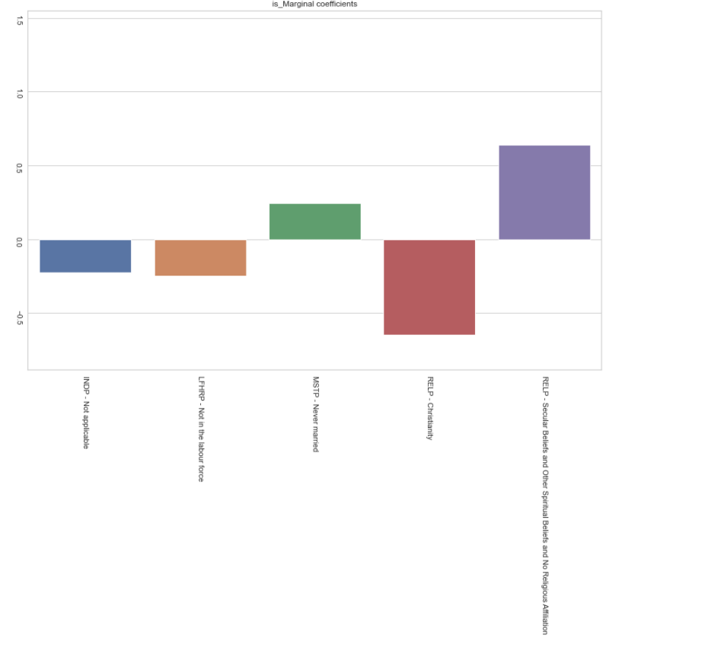
Results (Seat Type Model)
61% Accurate at predicting if an electorate is a Marginal seat.

Slide 12
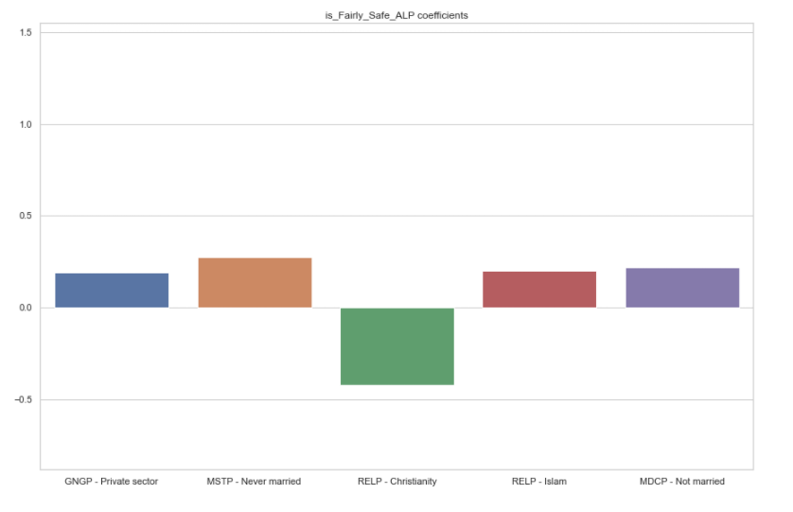
Results (Seat Type Model)
87% Accurate at predicting if an electorate is a fairly safe Labor seat.
Similar to the ALP category in the Major Party Model.

Slide 13
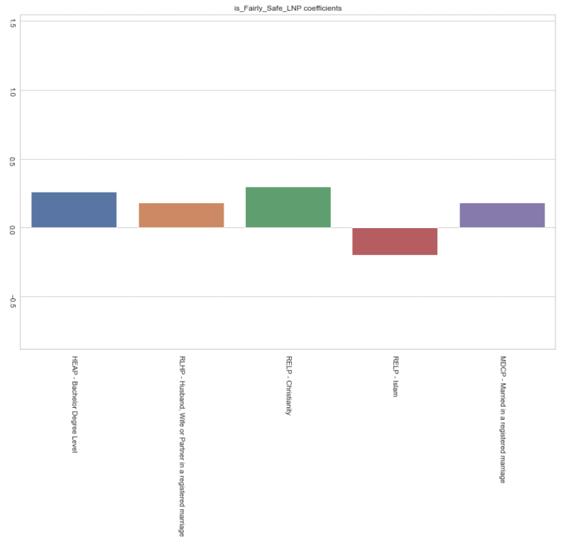
Results (Seat Type Model)
84% Accurate at predicting if an electorate is a fairly safe Liberal/ National coalition seat.
Religion features prominently.

Slide 14
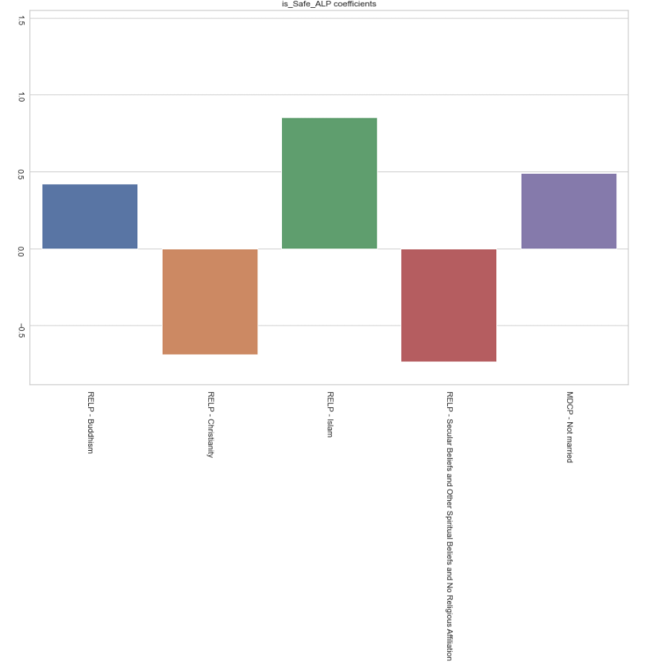
Results (Seat Type Model)
90% Accurate at predicting if an electorate is a safe Labor seat.
Religion is almost entirely the determining factor of whether we have a safe ALP seat.

Slide 15
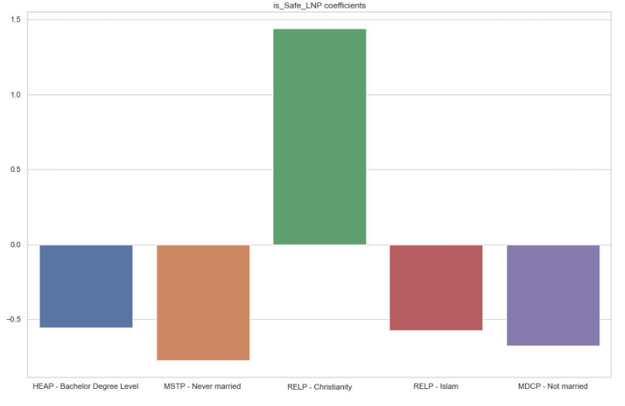
Results (Seat Type Model)
81% Accurate at predicting if an electorate is a Liberal/ National coalition safe seat.
Similar to LNP from Major Party Model.
Interesting contrast with Bachelor’s degree determining whether a seat is safe or fairly safe.

Slide 16
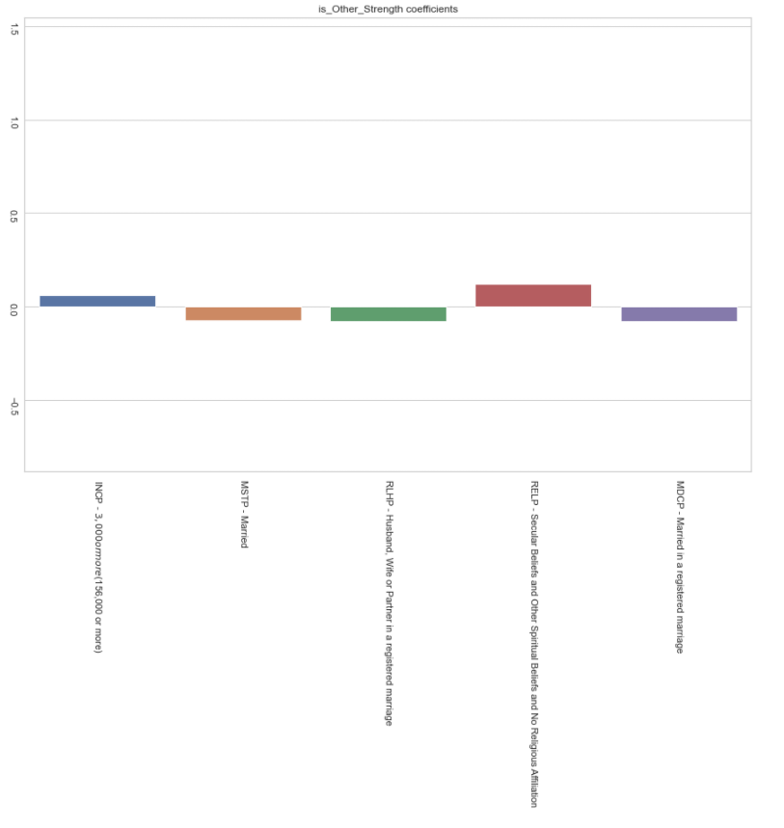
Results (Seat Type Model)
97% Accurate at predicting if an electorate is an Other seat.
Very weak coefficients, similar to Major Party Other with its issues.

Slide 17
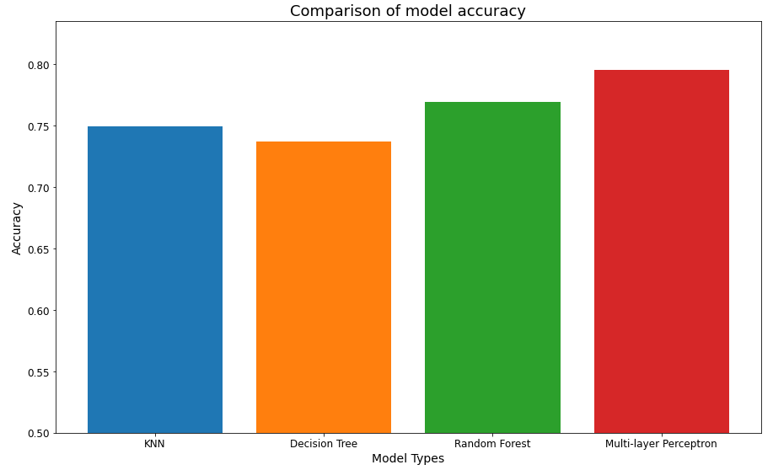
Non-regression models
Several non-regression models were evaluated,
K-Nearest Neighbours (KNN)
Decision Tree
Random Forest
Multi-layer Perceptron (MLP)
GridSearchCV was applied over hyper-parameter space for each model
KFolds used for cross-validation
Multi-layer Perceptron model gave best accuracy (~79.6%)
Non-regression model accuracies

Slide 18
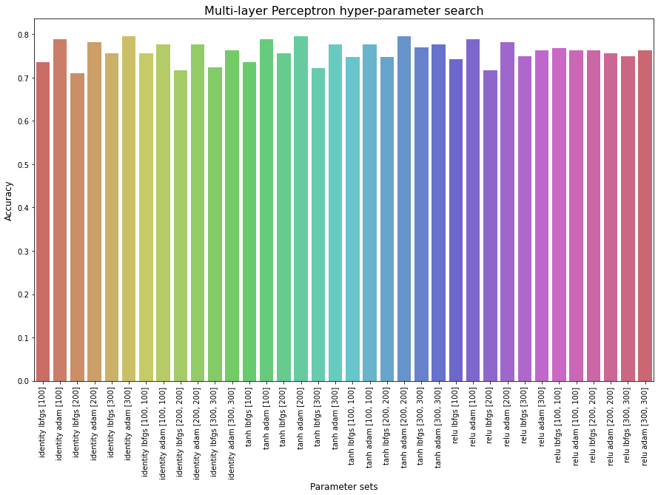
Multi-layer perceptron model
Using a grid search, the hyperparameters that resulted in the highest accuracy were,
Solver: adam
Hidden layers: 2 x 200
Activation function: tanh
Reducing the feature set to 13 helped reduce problems of overfitting
MLP model accuracies with different hyper-parameter sets

Slide 19
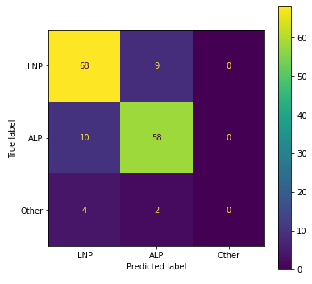
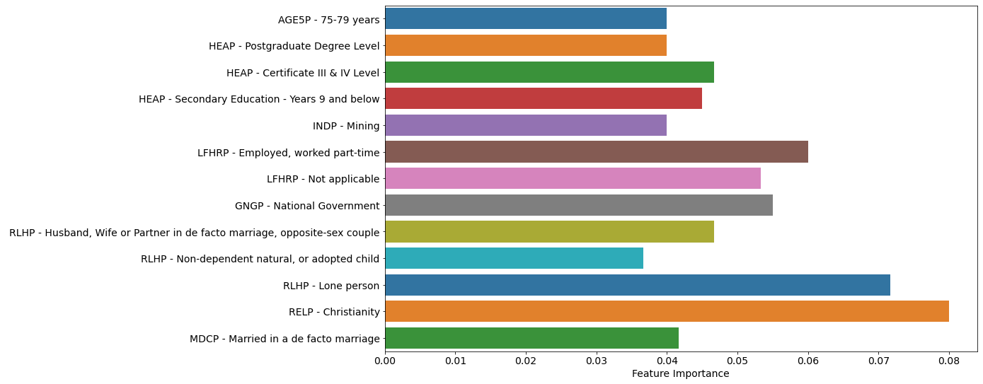
Results
Overall accuracy of final model was ~83.4%
83.7% accuracy training vs. 81.3% accuracy testing
Based on permutation importance, the following features were most important,
Religion (Christianity)
Marital/relationship status
Elderly population (75-79 years)
Education (school-leavers, vocational, post-graduate)
Employment status (part-time)
Occupation (Mining and Government Sector)
Confusion matrix for final MLP model
Features used in final MLP model and importances

Slide 20
Conclusions
We were able to achieve our primary goal as well as one of our secondary goals .
Both models agree that the proportion of people who are Christian per CED is the most important factor.
Whilst disagreeing on specifics, both models agree on Religion & Marital/ Relationship Status being the important factor.
Multi-layer Perceptron model had best overall accuracy compared to the Logistic Regression model
However, MLP model is a black-box estimator, cannot be interpreted as easily as Logistic Regression model

Slide 21
Caveats/Future Directions
Other factors that influence voting decisions
Popularity of specific candidates rather than parties
Small sample size
Only 151 CEDs had both census and voting data
Consider looking at other elections
Difficulties predicting for minor parties and independents
Changes to demography over time
Examine prior census data and evaluate trends

